Slide 1
Introduction to
Fusion Part 1.
Steve Cowley,
PPPL

Slide 2
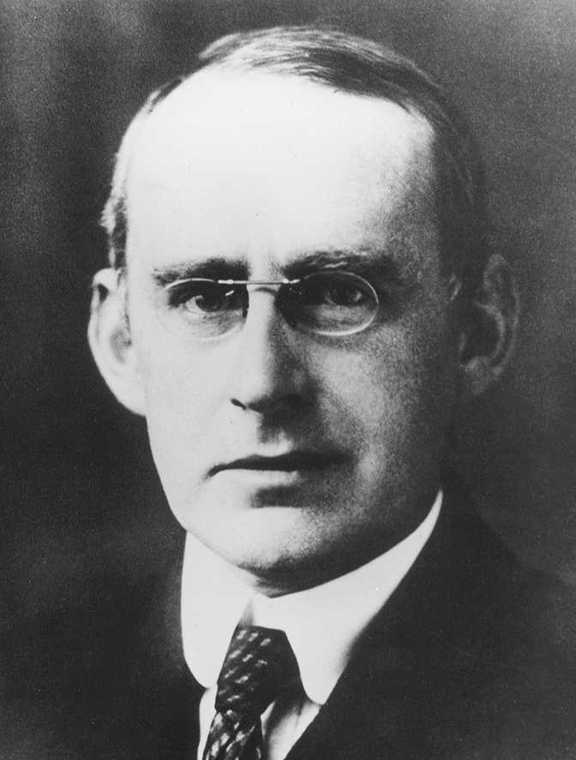
1920 The British Association
Arthur Stanley Eddington -- delivered the presidential address.
One of the many questions he addressed is:
Where does the energy radiated by
the stars/sun come from?
F. W. Aston had measured the masses of
elements and shown:
M_{hydrogen} = 1.008 and M_{helium}= 4.0
“F. W. Aston's experiments seem to leave no room for doubt that all
the elements (nuclei) are constituted out of hydrogen atoms bound
together with negative electrons”.

Slide 3
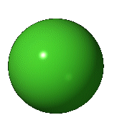
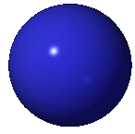
Simple Maths and E = mc²
Eddington assumed that the sun puts four hydrogens together to make helium.:
H + H + H + H ➔ He
Capture 2 electrons
Mass difference is energy by Einstein’s relation E= mc².
Hydrogen mass 1.00794 (atomic units) Mass of helium 4.0026
Thus approximately: 1.008 kilograms of hydrogen➔ 1 kilogram of Helium
8 grams ➔ 7.5 × 10¹⁴J of Energy.
That will supply you with all your energy needs for about 10,000 years.
Binding energy of nucleus

Slide 4
Where does the fusion energy come from?

Slide 5
Building a Nucleus
Repulsion of
Positive charges
Strong force
Binding energy per nucleon of a nucleus with
N_{p} protons and N_{n} neutrons.

Slide 6
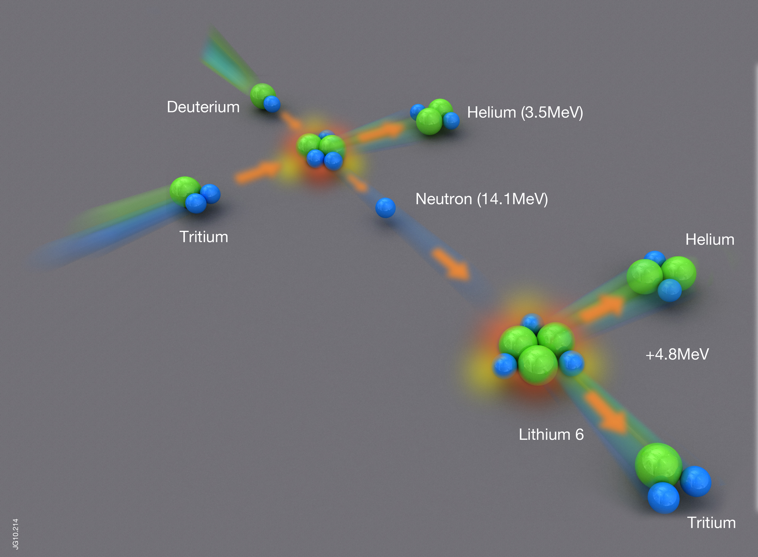
Which fusion?
Plasma at 200 miilion degrees
Blanket at ~ 600 degrees C
Enough lithium in sea to supply 30 million years of world energy needs

Slide 7
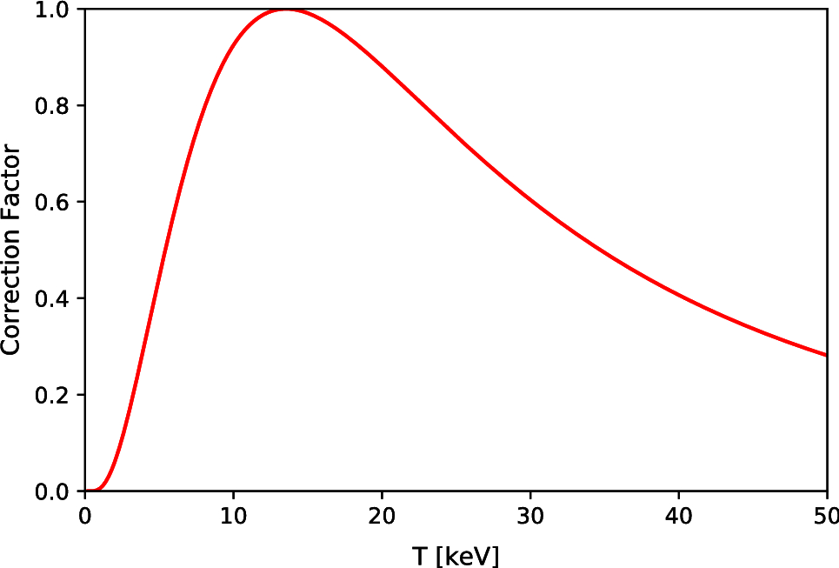
Reaction Rate
Deuterium Tritium reaction
Simple calculation yields
The power generated in
Each cubic meter.
Approximately
Deuterium Deuterium
Fusion Power Density
100 million degrees C
Plasma pressure in atmospheres. For a 50-50 DT mix.

Slide 8
Plasma
We need temperatures of ~200,000,000º C!
at these temperatures Deuterium D and
Tritium T are ionized – a PLASMA

Slide 9
Pressure
Ideal Gas Law roughly holds for plasmas
Boltzmann’s constant
Density of particles
What is the pressure of a plasma at 200,000,000º C?
Pressure of plasma
In atmospheres

Slide 10
Vessels can only hold a few tens or hundreds of
Atmospheres.
Therefore we can either do fusion in a very low
density plasma or in an exploding plasma.

Slide 11
Magnetic fusion – making a bottle

Slide 12
Motion of Particle in a Magnetic Field
Larmor Radius
See Will Fox’s lecture tomorrow at 13:30

Slide 13
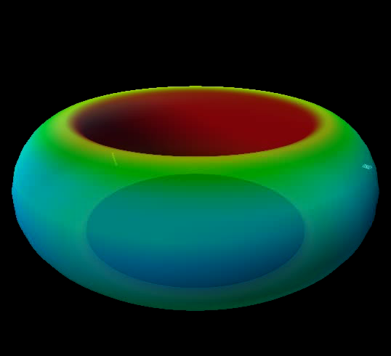

Slide 14
Magnetic Pressure
Magnetic Field has to push on the particles
Ampere’s law for a current carrying wire
Magnetic pressure
R
r

Slide 15
Equilibrium
Plasma Pressure
force
Ampere’s law
Magnetic pressure
force
Magnetic Curvature
force

Slide 16
Simple considerations – things we all know
For plasma at 10-20Kev temperatures (100-200MºC) D-T fusion power density is approximated by:
Plasma pressure in atmospheres
Magnetic pressure:
Figure of merit
Limited by stability:

Slide 17
Princeton – TFTR 1994, JET 1997
Could we sustain these fusion grade plasmas?

Slide 18
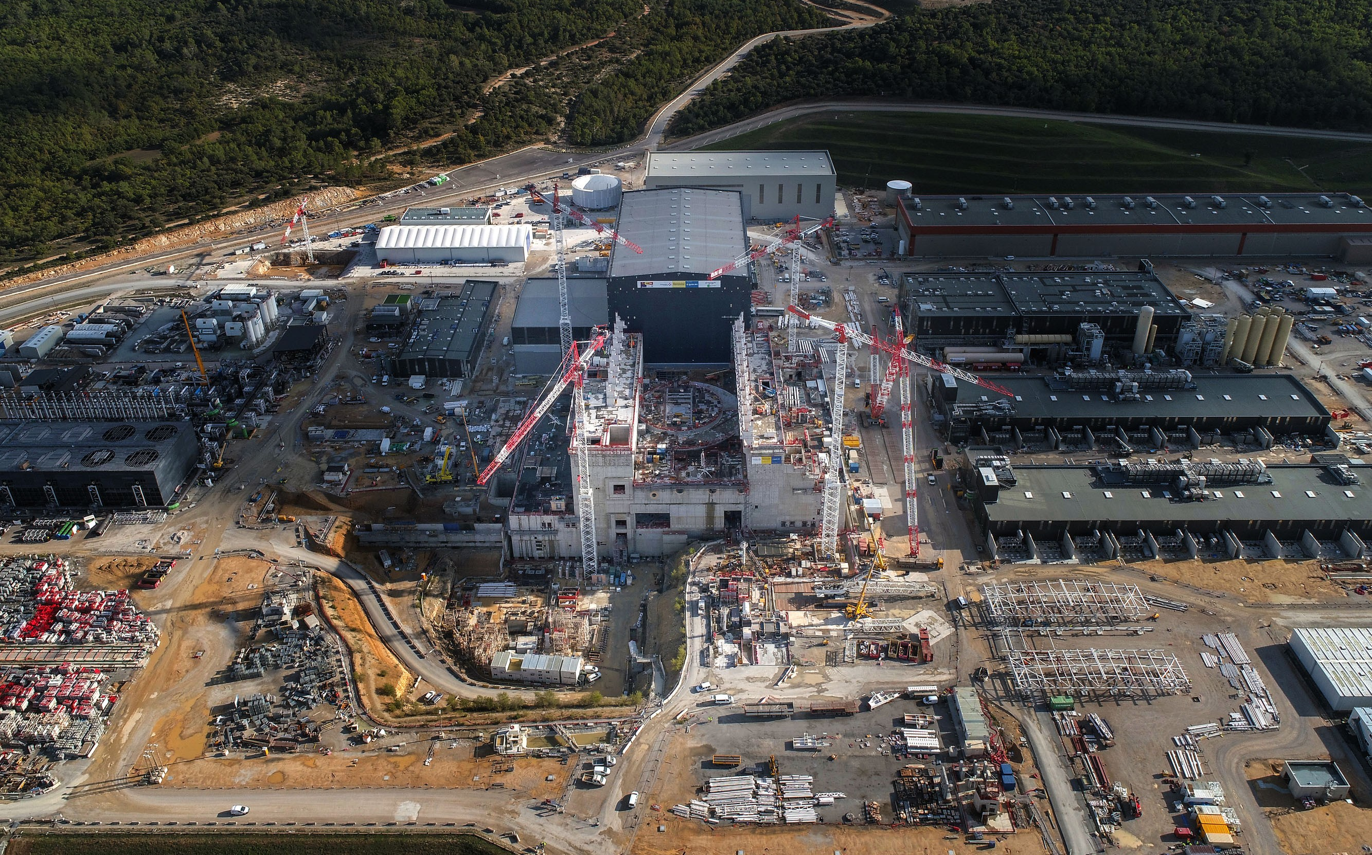
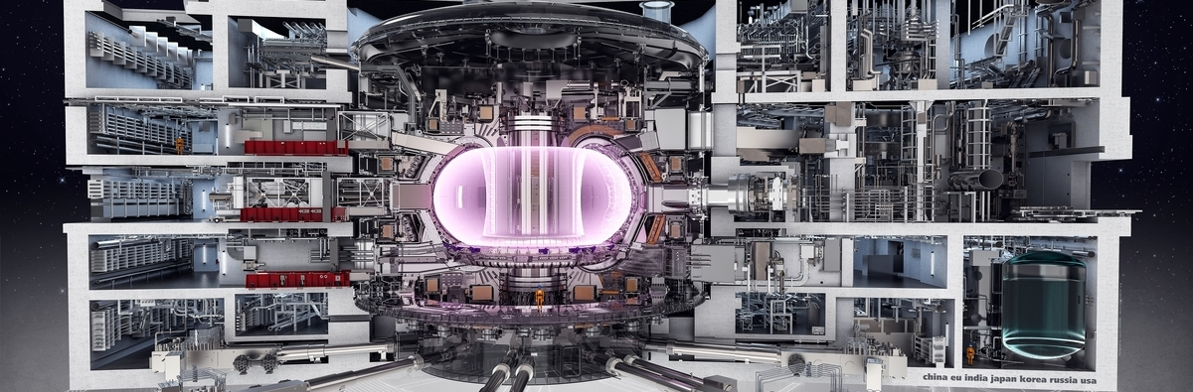
ITER
>$20B
Central Pressure = 7 Atmospheres.
Magnetic field = 5.2T
Current up to 15 million amps.

Slide 19
What will ITER do?

Slide 20
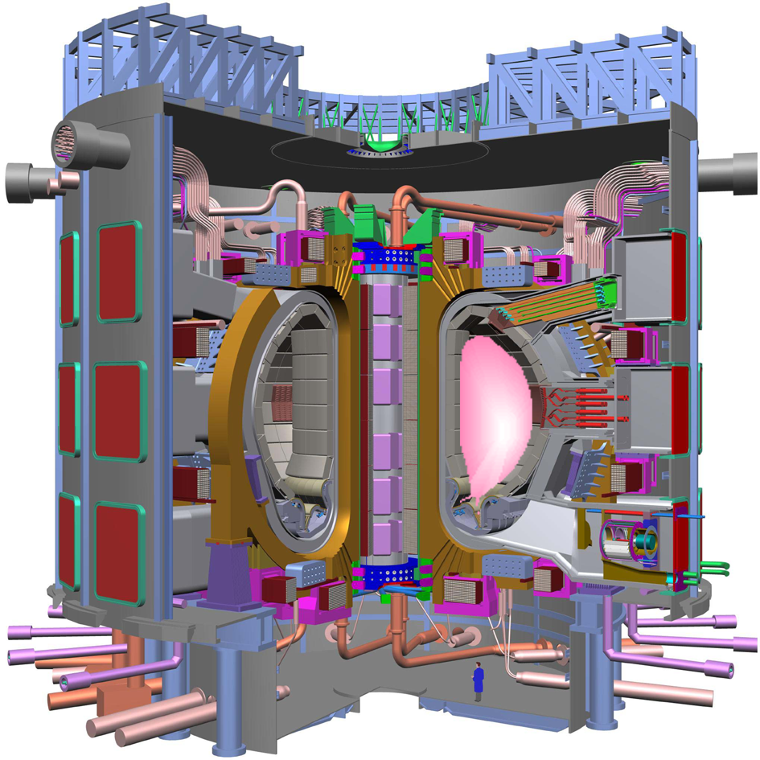


Fusion Energy Balance in ITER
Turbulent Plasma Energy Loss
Confinement Time in seconds
External Plasma heating
P_{Heat}~50MW
Energy Balance
Energy Gain = Q > 10

Slide 21
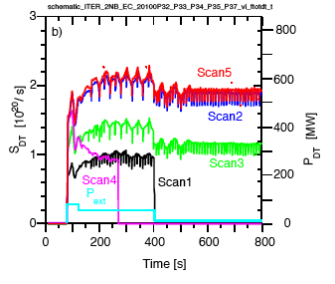
Simulation by Bob Budny: Based on JET results from 2008-2013
Fusion
Power
(MW)
P_{α} = (Stored Plasma Energy)/𝝉_{E}
BURNING PLASMA
Heating
Power (MW)

Slide 22
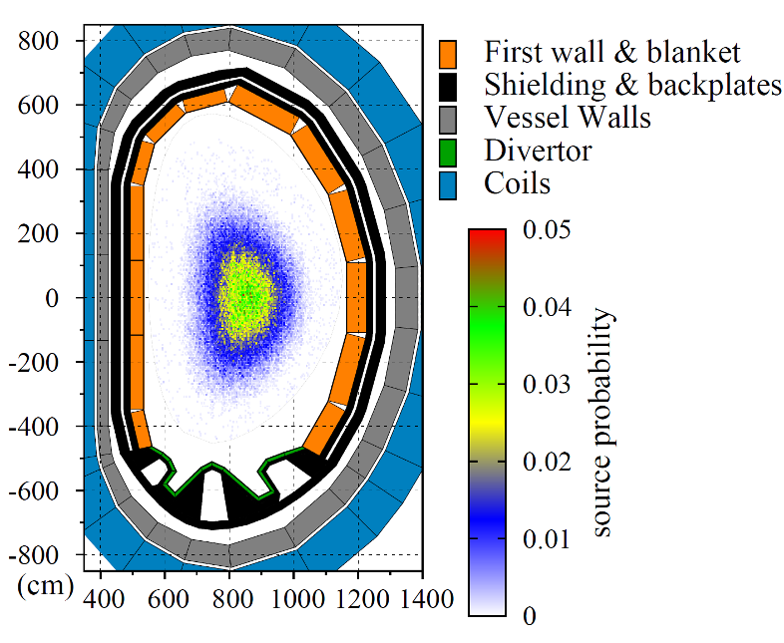
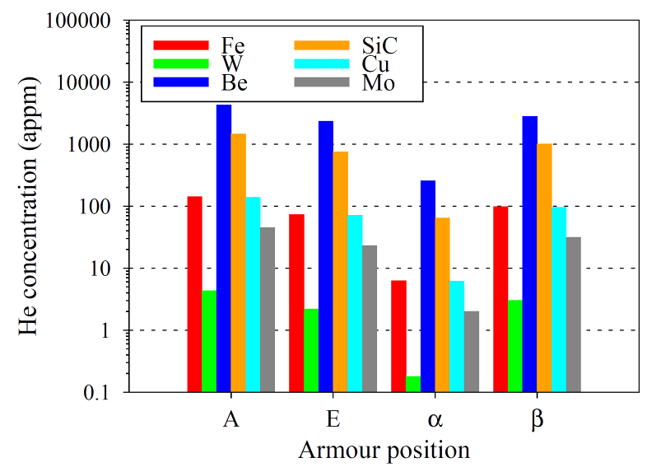
Assessment of materials lifetime: an integrated approach
See Lauren Garrison’s talk
Tuesday next week
Plasma as a 3D neutron source
Neutron spectra at various locations in a tokamak
Rule of thumb.
1MW per square meter of wall moves each atom in he wall ten times in a “full power year”.
Transmutation cross-section data are required to predict helium-induced grain boundary embrittlement
Defect production, giving rise to radiation embrittlement
M.R. Gilbert et al., Nucl. Fusion 52 (2012) 083019;
J. Nucl. Mater. 442 (2013) S755
A. Sand et al. EPL 103 (2013) 46003
Notes:
An approach integrating models for neutron transport and models
describing the effects of neutrons on properties of materials
has been recently developed at CCFE as means for assessing the
lifetime of materials in the extreme environment of a fusion
(or a fission) power plant. A detailed treatment of neutron
transport is a necessary element of any design study as neutron
spectra at any location in the device form as a result of
multiple events of scattering of neutrons within the structure.
For example, a significant proportion of neutrons bombarding
plasma facing materials in fact is back-scattered by the
structure itself, highlighting the significance of full neutron
transport models as a part of engineering design process.

Slide 23

So you thought you had Tungsten on the Wall
Thanks to M.R. Gilbert
Refractory metals
Notes:
This slide illustrates, in a 3D model of a DEMO power plant,
the variation of neutron spectra as a function of location in a
operational fusion power plant. The movies illustrate the
effect of transmutation resulting from exposure of materials to
fusion neutrons. light elements like beryllium exhibit high
rates of transmutation reactions producing helium and hydrogen,
whereas tungsten transmutes into rhenium and osmium - in the
latter case the low energy neutrons, backscattered and slowed
down in the structure rather than neutrons emerging directly
from the burning plasma, predominantly cause the transmutation
reactions [this is an unusual and not often appreciated fact -
for example, testing tungsten in fission reactors is not
representative unless specimens are well shielded from the low
energy neutrons].

Slide 24
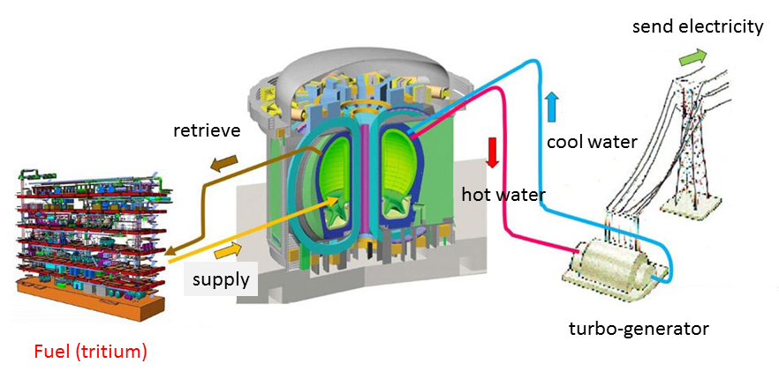
Neutrons to Electricity – Balance of Plant
Blanket design – see Chuck Kessel’s talk 4pm next monday

Slide 25
End of Part 1.

